Slide 1
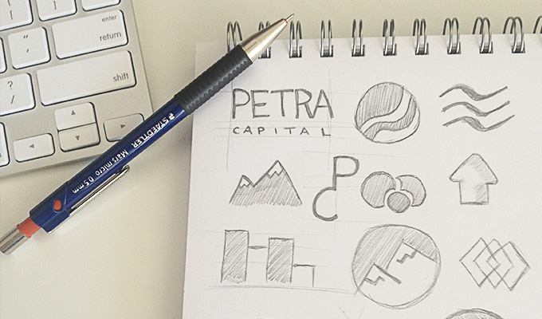
HOW TO DEVELOP A LOGO
Computer Graphics

Slide 2
Today’s task:
You have been asked to design a new logo for an athletic shoe company. You must come up with a concept for what you want to design by the end of this powerpoint.
Need: Paper & Pencil

Slide 3
Questions you must answer…
Who are you designing this for?
What “personality” does their brand have?
Who is their target market?
What do they want their customers to think of them?
What colors and fonts best represent them?

Slide 4
Who are you designing for?
The client (a logo to represent them)
The clients customer (a logo that communicates value/product that the customer is looking for)
Yourself

Slide 5
How can a brand have a “personality”?
(Human characteristics we assign to something.)
List the personality area and traits your brand has. Use the following chart.

Slide 7
Why define the brand personality?
This is what you convey to the customer.
Clarifies what the brand is about to everyone.
Most importantly, it helps you decide how to make the logo.

Slide 8
Defining the target market and communicating the brand to them
This is important because…
If you understand what the target market wants, then you can create a logo to communicate that you (or the client) can meet that want.
How brands have done this: http://www.designopsy.com/logos-hidden-messages/

Slide 9
Class Discussion: Who is the brand targeted to?
Age:
Income level:
Gender:
What is important to them (values, music, etc.):

Slide 10
Choose the type of logo you want to create

Slide 13
Color Psychology
Choose colors that your target market connect with, but also represent your brands message.
http://www.entrepreneur.com/article/233843
http://www.creativebloq.com/branding/choose-colour-logo-design-8133973

Slide 14
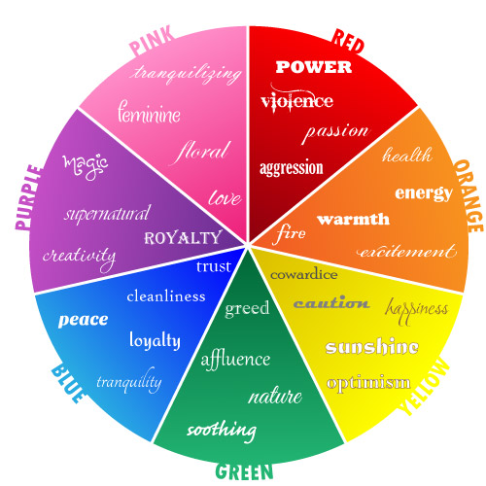

Slide 15
Typography
Typography is the style and appearance of the written word.
Fonts have personalities.
Choose a font that has a personality that represents your brand.

Slide 17
HW: Putting it all together
You will take your concept and find examples of logos that inspire you and turn in via google doc.
Use dribbble.com and pinterest and grab 3+ examples of logos that inspire your design.
Explain how those examples represent the kind of logo you envision for your brand.
Explain your color and font choices and why you chose those, and how they represent the brand.

